Slide 1

Optimizing in the Dark: Learning an Optimal Solution Through a Simple Request Interface
Qiao Xiang¹², Haitao Yu¹, James Aspnes²,
Franck Le³, Linghe Kong⁴, Y. Richard Yang¹²
¹Tongji University, ²Yale University,
³IBM T.J. Watson Research Center, ⁴Shanghai JiaoTong University,
January 2019, Honolulu, AAAI'19

Slide 2
A Fairy Tale Question
Ask for a wish. I can tell you if I can give it to you.
What is the BEST wish he can give me?

Slide 3
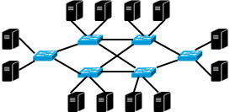
Fairy Tale in Network
Network resource reservation systems are being deployed, driven by the demand and substantial benefits of providing predictable network resources for modern distributed applications (e.g., Hadoop and Spark) .
A simple reservation interface is provided for users to submit requests for reserving a specific amount of bandwidth, and return either success or failure.
Request bandwidths for flows. I can tell you if you can get them.
What are the optimal bandwidths I can get from network?

Slide 4
Previous Proposals
Require the network to provide network resource information to the user
Expose the private information of network (e.g., topology, policy and bandwidth capacity) to user, resulting in security vulnerability
Require the user to provide her objective for choosing resources
Expose the private information of user (e.g., internal orchestration policy) to network, allowing the network to violate the network neutrality

Slide 5
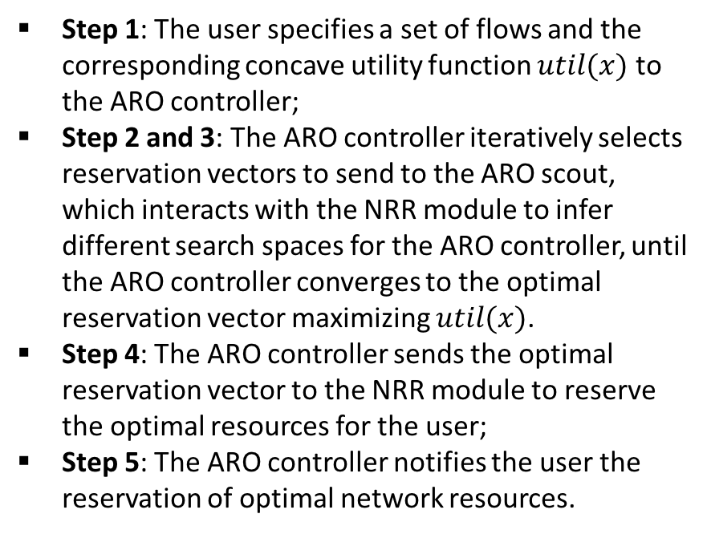
Our Solution: BoxOpt
How can this be done?
The first working learning system that automatically learns the optimal resource reservations without exchanging any private information between the network and the user.
Step 1: The user specifies a set of flows and the corresponding concave utility function $util(x)$ to the ARO controller;
Step 2 and 3: The ARO controller iteratively selects reservation vectors to send to the ARO scout, which interacts with the NRR module to infer different search spaces for the ARO controller, until the ARO controller converges to the optimal reservation vector maximizing $util(x)$.
Step 4: The ARO controller sends the optimal reservation vector to the NRR module to reserve the optimal resources for the user;
Step 5: The ARO controller notifies the user the reservation of optimal network resources.
Step 1
User
ARO Controller
Step 5
Step 2
Inferred
Search Space
Step 4
Automatic
Reservation Optimization
Module
Success
Reservation
Vector
Optimal
Reservation
Vector
Step 3
ARO Scout
Reservation
Vector
Success /
Failure
Network
Network Resource
Reservation Module
Architecture and workflow of BoxOpt

Slide 6
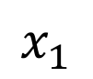
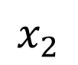
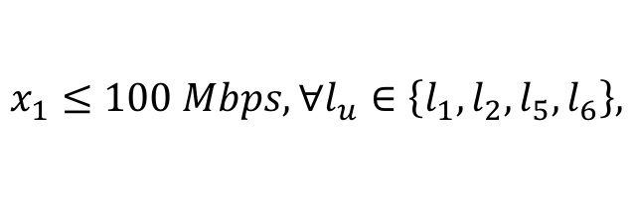
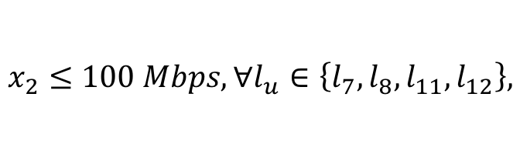
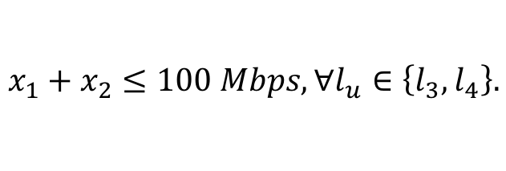

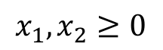
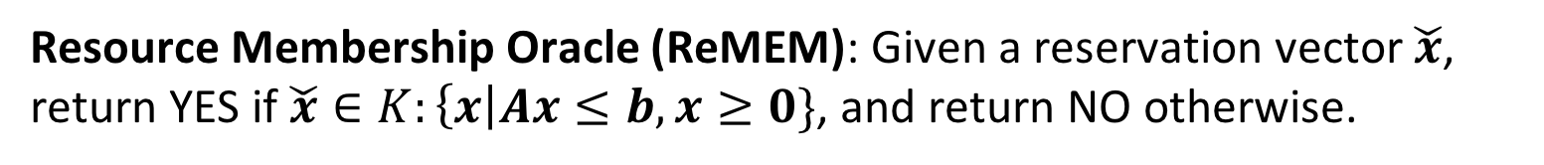
Simple Reservation Interface as a Resource Membership Oracle
The NRR module uses linear inequalities to model the bandwidth availability and sharing information of flows.
Resource Membership Oracle (ReMEM): Given a reservation vector $\check{x}$, return YES if $\check{x}∈K:\left\{x\right|Ax≤b, x≥0\}$, and return NO otherwise.
Bandwidth feasible region $K$
$$x_{1}≤100 Mbps, ∀l_{u}∈\left\{l_{1},l_{2},l_{5},l_{6}\right\},$$
$$x_{1}$$
100
$$x_{2}≤100 Mbps, ∀l_{u}∈\left\{l_{7},l_{8},l_{11},l_{12}\right\},$$
$$x_{1}+x_{2}≤100 Mbps, ∀l_{u}∈\left\{l_{3},l_{4}\right\}.$$
$$x_{2}$$
$$x_{1}, x_{2}≥0$$
100

Slide 7
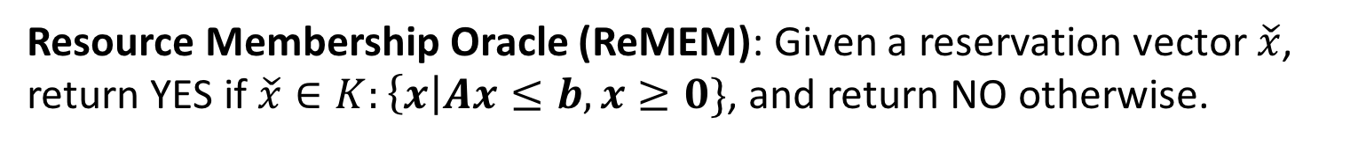
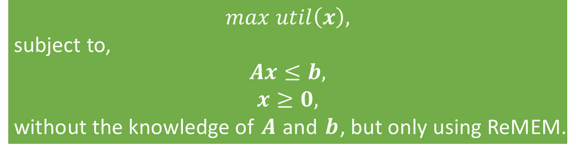
Optimization via Membership Oracle: Problem Definition
Resource Membership Oracle (ReMEM): Given a reservation vector $\check{x}$, return YES if $\check{x}∈K:\left\{x\right|Ax≤b, x≥0\}$, and return NO otherwise.
$$max util\left(x\right),$$
subject to,
$$Ax≤b,$$
$$x≥0,$$
without the knowledge of $A$ and $b$, but only using ReMEM.

Slide 8
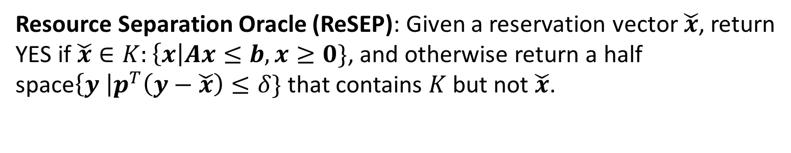
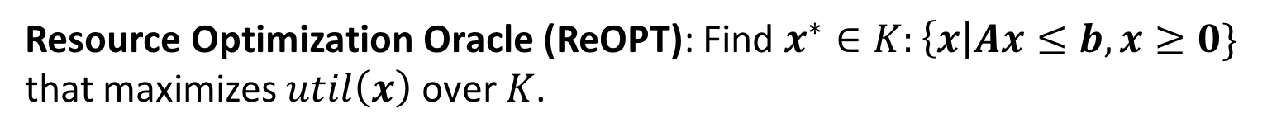
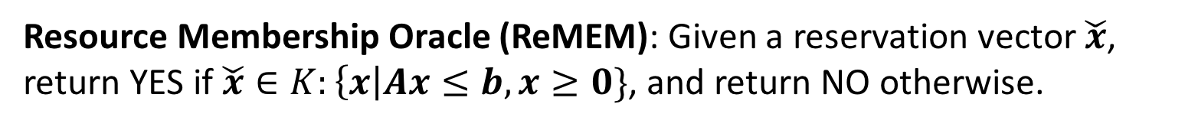
Optimization via Membership Oracle: Basic Idea
Other than membership oracles, there are other basic oracles in optimization theory.
Resource Membership Oracle (ReMEM): Given a reservation vector $\check{x}$, return YES if $\check{x}∈K:\left\{x\right|Ax≤b, x≥0\}$, and return NO otherwise.
Resource Separation Oracle (ReSEP): Given a reservation vector $\check{x}$, return YES if $\check{x}∈K:\left\{x\right|Ax≤b, x≥0\}$, and otherwise return a half space$\left\{y \right|p^{T}\left(y−\check{x}\right)≤δ\}$ that contains $K$ but not $\check{x}$.
Resource Optimization Oracle (ReOPT): Find $x^{∗}∈K:\left\{x\right|Ax≤b, x≥0\}$ that maximizes $util\left(x\right)$ over $K$.
Different basic oracles in optimization theories have equivalence and polar relationships.

Slide 9
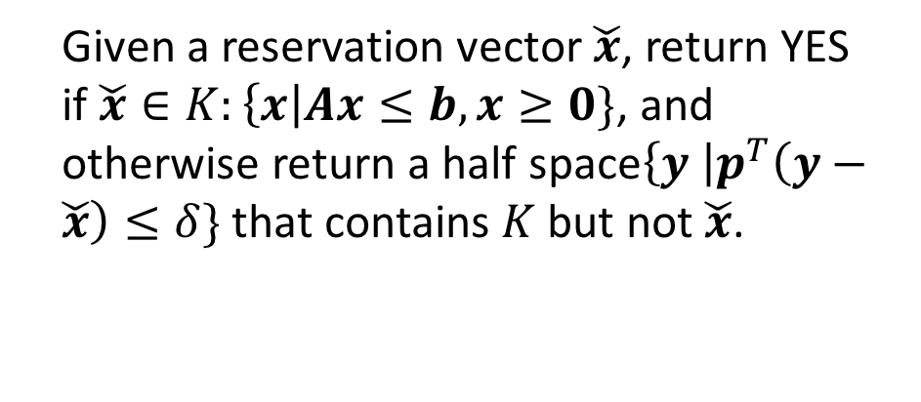
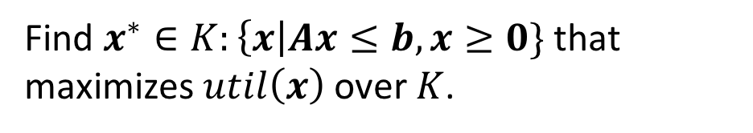
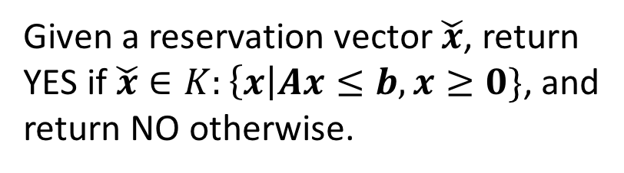
Optimization via Membership Oracle: Roadmap
Resource
Optimization Oracle
Find $x^{∗}∈K:\left\{x\right|Ax≤b, x≥0\}$ that maximizes $util\left(x\right)$ over $K$.
Reservation
Vector
Yes /
Separation Half Space
Given a reservation vector $\check{x}$, return YES if $\check{x}∈K:\left\{x\right|Ax≤b, x≥0\}$, and otherwise return a half space$\left\{y \right|p^{T}\left(y−\check{x}\right)≤δ\}$ that contains $K$ but not $\check{x}$.
Resource
Separation Oracle
Reservation
Vector
Yes / No
Given a reservation vector $\check{x}$, return YES if $\check{x}∈K:\left\{x\right|Ax≤b, x≥0\}$, and return NO otherwise.
Resource
Membership Oracle

Slide 10
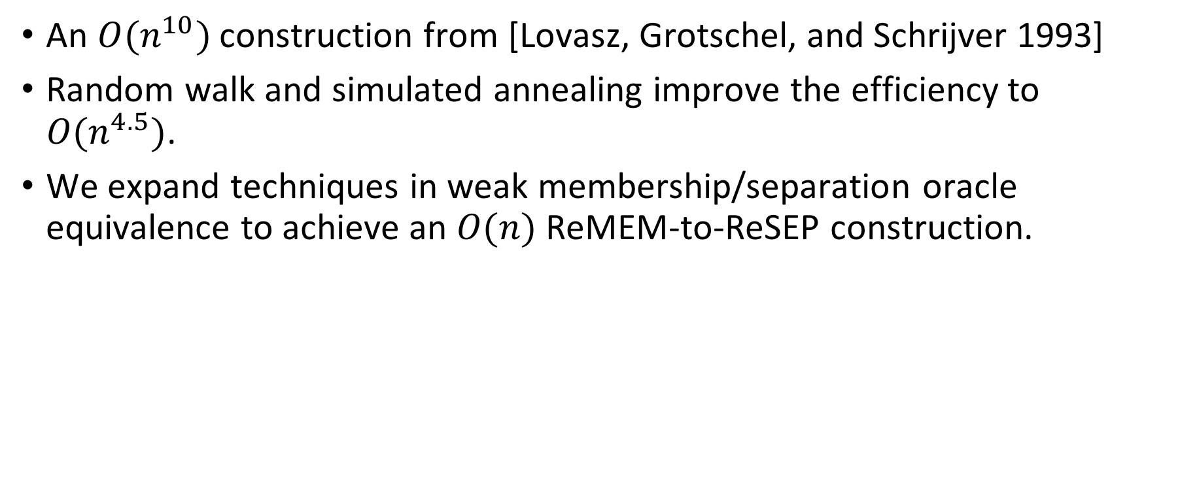
From ReMEM to ReSEP
An $O(n^{10})$ construction from [Lovasz, Grotschel, and Schrijver 1993]
Random walk and simulated annealing improve the efficiency to $O(n^{4.5})$.
We expand techniques in weak membership/separation oracle equivalence to achieve an $O(n)$ ReMEM-to-ReSEP construction.

Slide 11


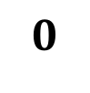
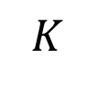
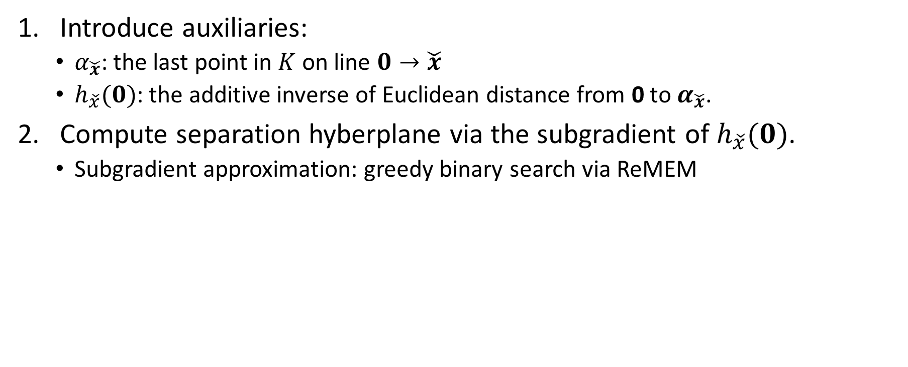
From ReMEM to ReSEP: Basic Idea
Introduce auxiliaries:
$α_{\check{x}}$: the last point in $K$ on line $0→\check{x}$
$h_{\check{x}}(0)$: the additive inverse of Euclidean distance from 0 to $α_{\check{x}}$.
Compute separation hyberplane via the subgradient of $h_{\check{x}}(0)$.
Subgradient approximation: greedy binary search via ReMEM
$$\check{x}$$
$$K$$
$$α_{\check{x}}$$
$$0$$

Slide 12
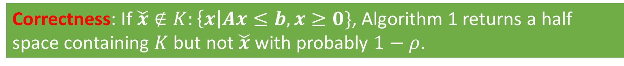
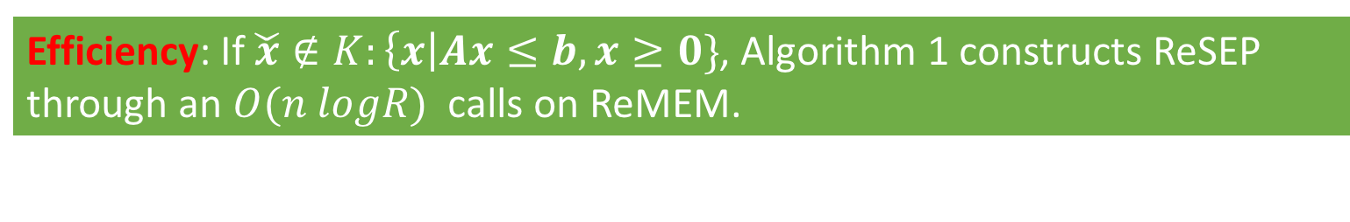
From ReMEM to ReSEP: Analysis
Correctness: If $\check{x}∉K:\left\{x\right|Ax≤b, x≥0\}$, Algorithm 1 returns a half space containing $K$ but not $\check{x}$ with probably $1−ρ$.
Efficiency: If $\check{x}∉K:\left\{x\right|Ax≤b, x≥0\}$, Algorithm 1 constructs ReSEP through an $O(n logR)$ calls on ReMEM.

Slide 13

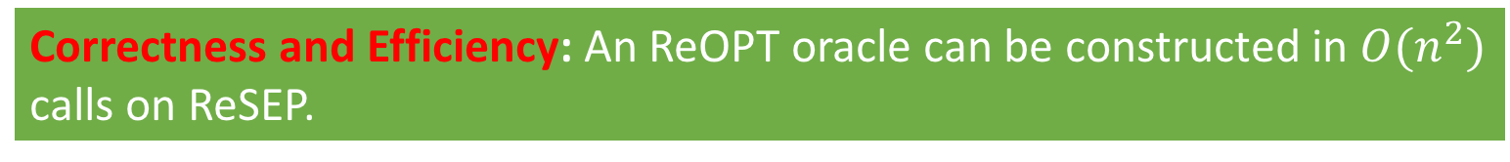
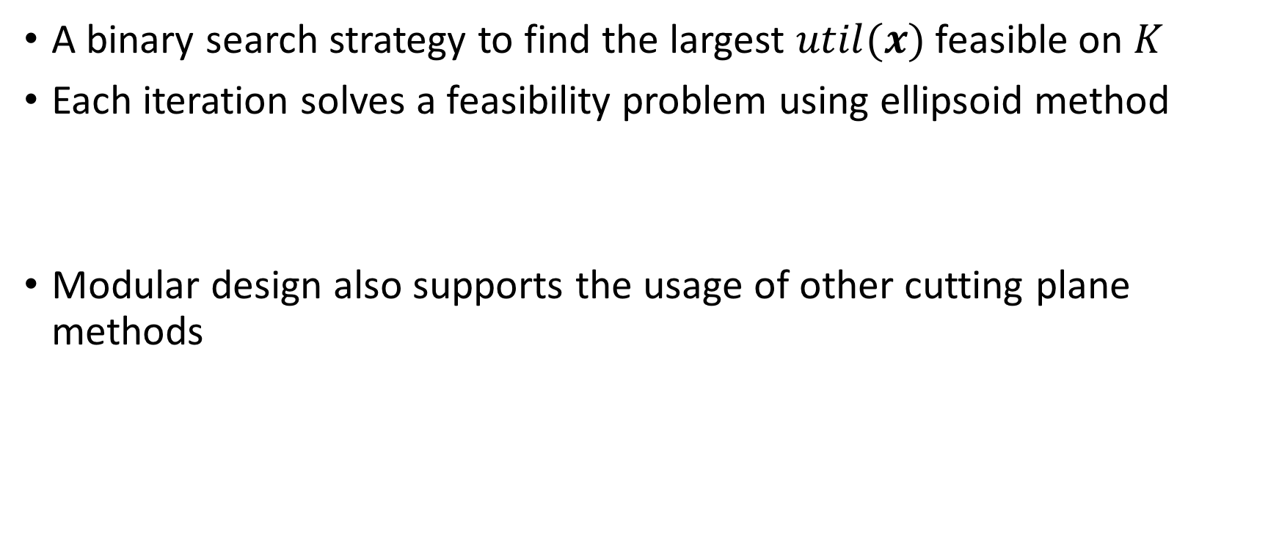
From ReSEP to ReOPT
A binary search strategy to find the largest $util(x)$ feasible on $K$
Each iteration solves a feasibility problem using ellipsoid method
Modular design also supports the usage of other cutting plane methods
$$util\left(x\right)≥u_{next},$$
$$Ax≤b,$$
$$x≥0,$$
Correctness and Efficiency: An ReOPT oracle can be constructed in $O(n^{2})$ calls on ReSEP.

Slide 14
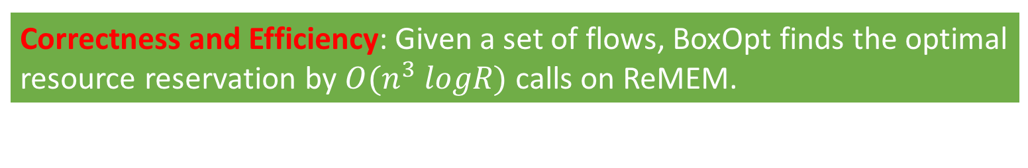
Putting Things Together
ARO Controller
Resource
Optimization Oracle
Reservation
Vector
Inferred
Search Space
Reservation
Vector
Yes /
Separation Half Space
ARO Scout
Resource
Separation Oracle
Reservation Vector
Success / Failure
Reservation
Vector
Yes / No
Network Resource Reservation Module
Resource
Membership Oracle
Correctness and Efficiency: Given a set of flows, BoxOpt finds the optimal resource reservation by $O(n^{3} logR)$ calls on ReMEM.

Slide 15
Performance Evaluation
Topology: a large science federation network (LHCONE) with 62 institutes and hundreds of network elements (i.e., switches/routers)
Traffic: a 48-hour flow reservation trace in LHCONE with a total of 716 reservation requests
Number of flows in each request ranges from 1 to 7.
Users' objective function: maximal throughput and maximal weighted throughput
Metrics: correctness, efficiency and scalability of BoxOpt

Slide 16
Correctness of BoxOpt
In all 716 requests, BoxOpt computes the same optimal resource reservations as computed by CPLEX, i.e., BoxOpt achieves a 100% correctness ratio.

Slide 17
Efficiency and Scalability of BoxOpt
Communication latency of BoxOpt with different sizes of request.
CDF of the communication latency of BoxOpt.
For 95% of requests, BoxOpt learns the optimal resource reservation within 13 seconds (assuming the user is in NYC and the network is in LA)

Slide 18
Efficiency Breakdown: from ReMEM to ReSEP
Number of ReMEM invocations with different sizes of request.
CDF of the number of ReMEM invocations.
In BoxOpt, 95% of ReSEP can be constructed within less than 30k ReMEM calls.

Slide 19
Efficiency Breakdown: from ReSEP to ReOPT
Number of ReSEP invocations with different sizes of request.
CDF of the number of ReSEP invocations.
In BoxOpt, 95% of ReOPT can be constructed within less than 200 ReSEP calls.

Slide 20
Summary
Network resource reservation systems are inefficient for the user to find the optimal resource reservation
Previous proposals require network/user to expose private information
BoxOpt: the first working learning system that automatically learns the optimal resource reservations without exchanging any private information between the network and the user.
Future Work
Privacy-preserving traffic engineering
Resource orchestration for collaborative data analytics

Slide 21
Backup Slides

Slide 22
Background: Reservation Systems are Blackboxes
User
Representative: PCE, OSCARS and etc.
Basic idea: Simple interface reserve(flow_list, bw_values) with success/failure response
Advantages: simple, widely used
Drawback: almost impossible to find the optimal amount of resources to reserve
E.g., maximize total throughput for a set of flows
Flow set,
Bandwidth Values
Success / Failure
Reservation System
Network

Slide 23
Overview
Driving question: Can the user learn the optimal network resource reservation using only the simple reservation interface provided by blackbox-request based reservation systems?
Solution: BoxOpt, a novel learning system that automatically learns the optimal resource reservations without exchanging any private information between the network and the user.
Private information of network: ALTO-path vector abstraction
Private information of user: objective function

Slide 24
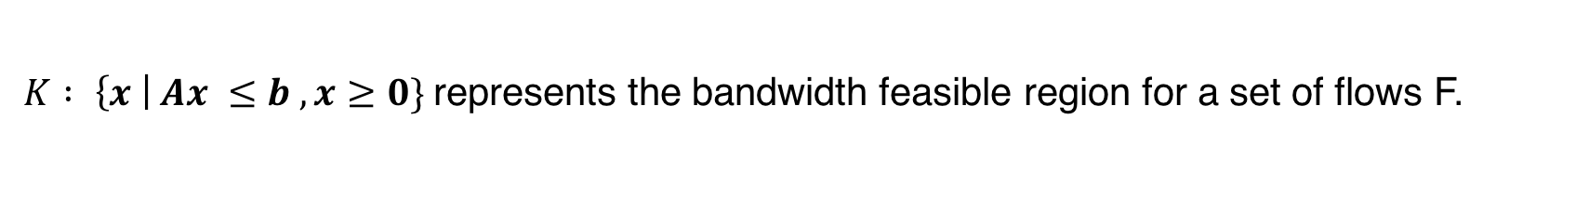
Problem formulation
$K : \left\{x \right| Ax ≤b , x≥0\}$represents the bandwidth feasible region for a set of flows F.

Slide 25
Basic idea
Ellipsoid Method
Modified Mem2Sep Algorithm from [1]
[1] Lee, Yin Tat, Aaron Sidford, and Santosh S. Vempala. "Efficient Convex Optimization with Membership Oracles." arXiv preprint arXiv:1706.07357 (2017).

Slide 26
Simple Reservation Interface as a Membership Oracle
Step 1
User
ARO Controller
Resource
Optimization Oracle
Step 5
Step 2
Inferred
Search Space
Step 4
Automatic
Reservation Optimization
Module
Success
Yes /
Separation
Half Space
Section
3.4
Reservation
Vector
Optimal
Reservation
Vector
Reservation
Vector
Step 3
ARO Scout
Resource
Separation Oracle
Reservation
Vector
Success /
Failure
Reservation
Vector
Section
3.3
Network
Yes / No
Network Resource Reservation Module
Resource
Membership Oracle

Slide 27
Results
716 flow-set requests on LHCONE/Topology Zoo topology
100% correctness ratio
For 95% of requests, BoxOpt learns the optimal resource reservation within 13 seconds (assuming the user is in NYC and the network is in LA)

